Slide 1
Hash Table
Hash Table

Slide 11
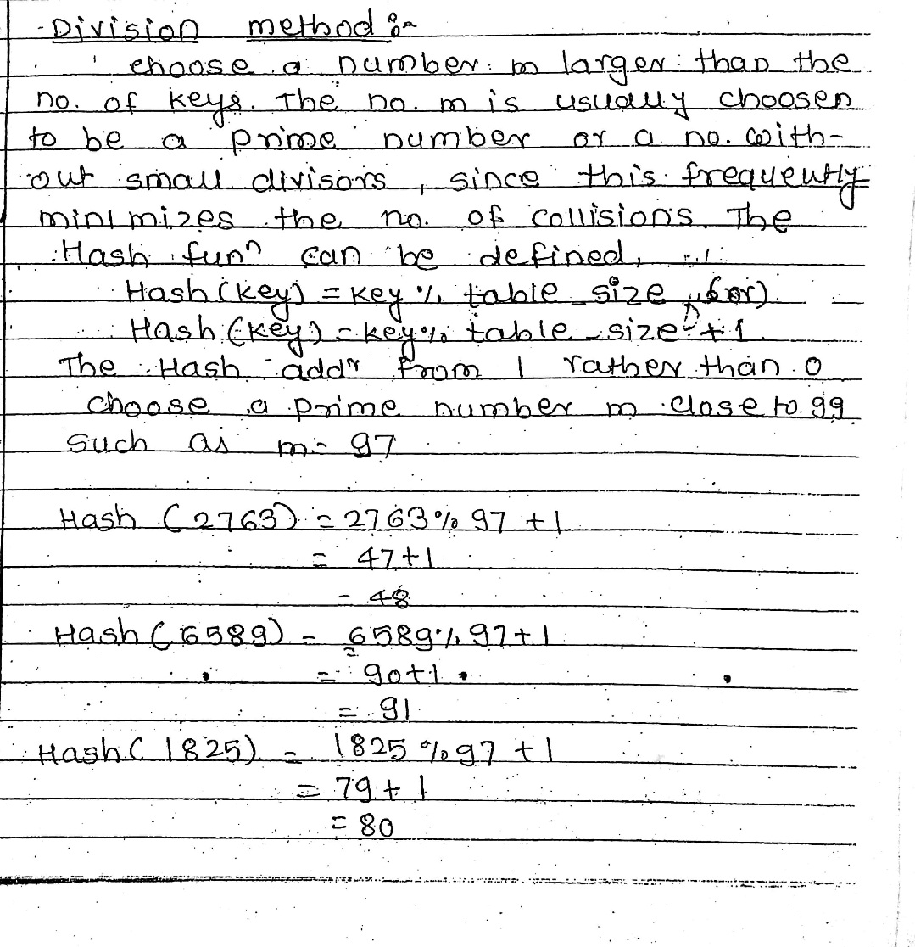
Methods of Hash Function

Slide 12
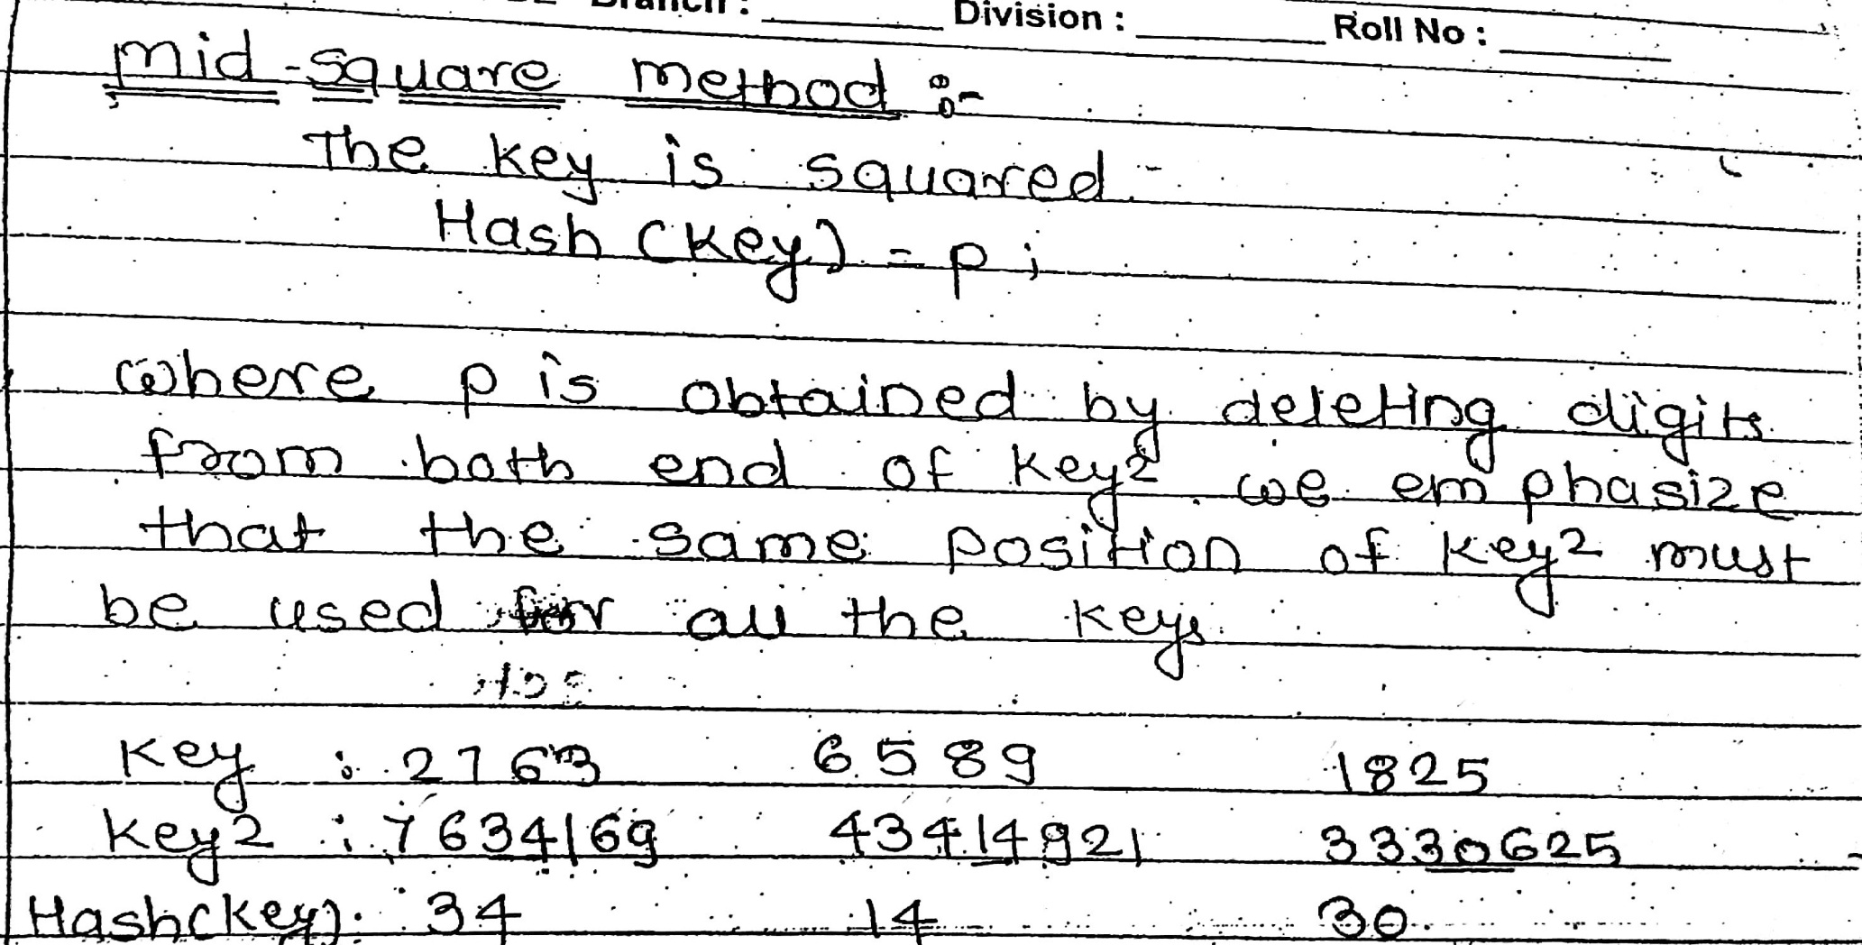

Slide 13
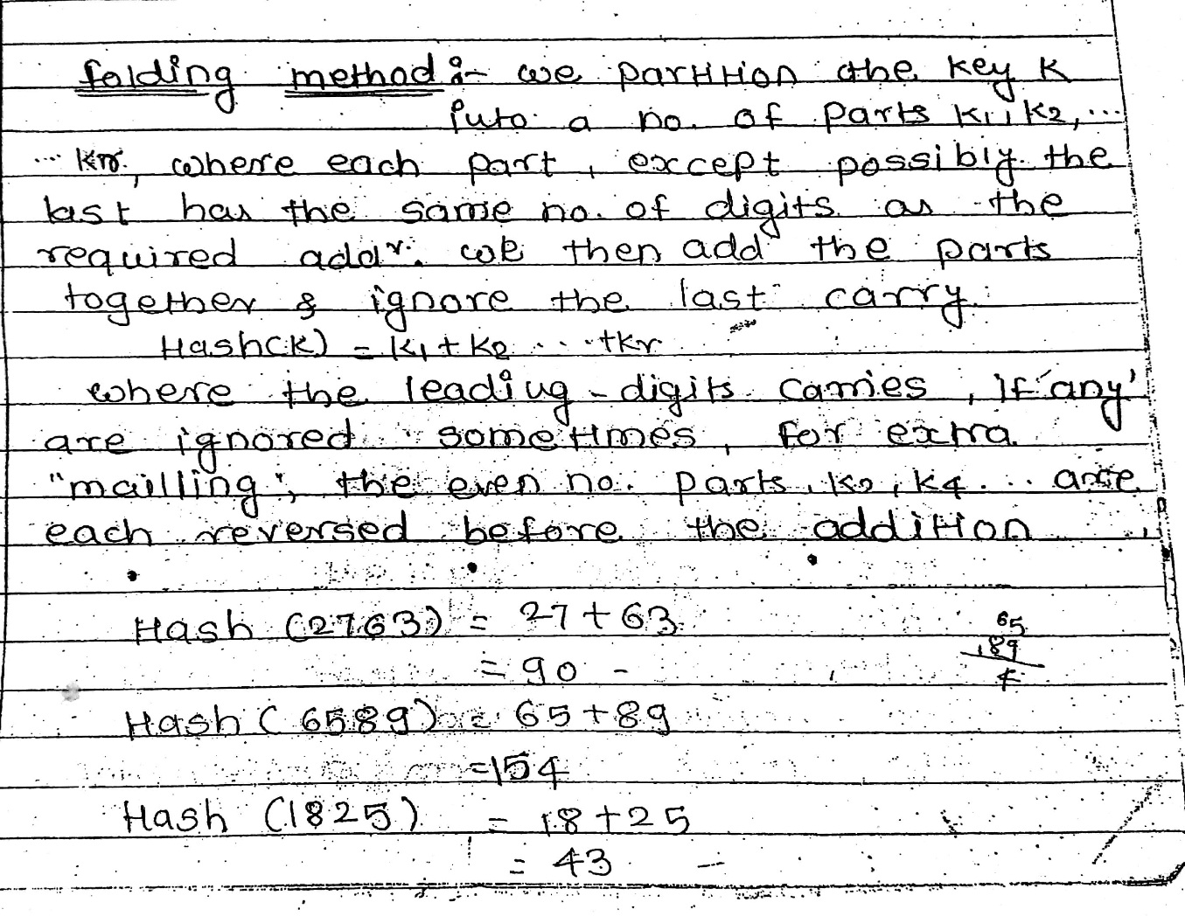
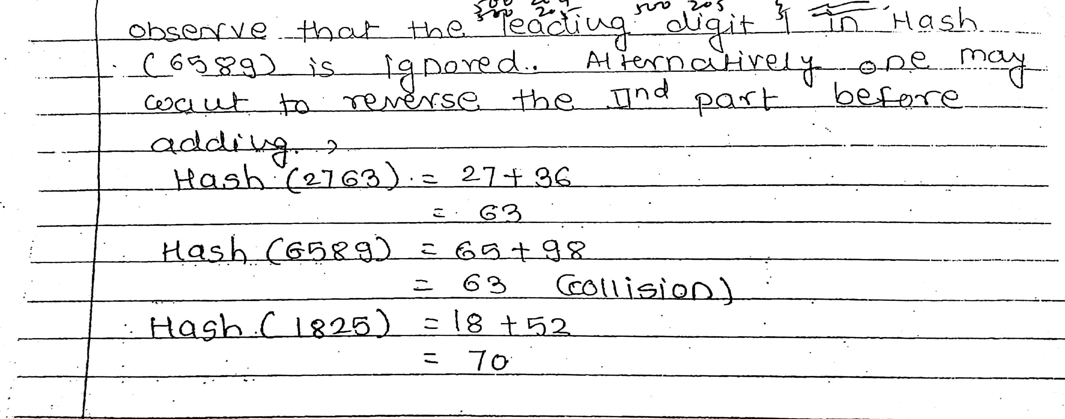

Slide 14
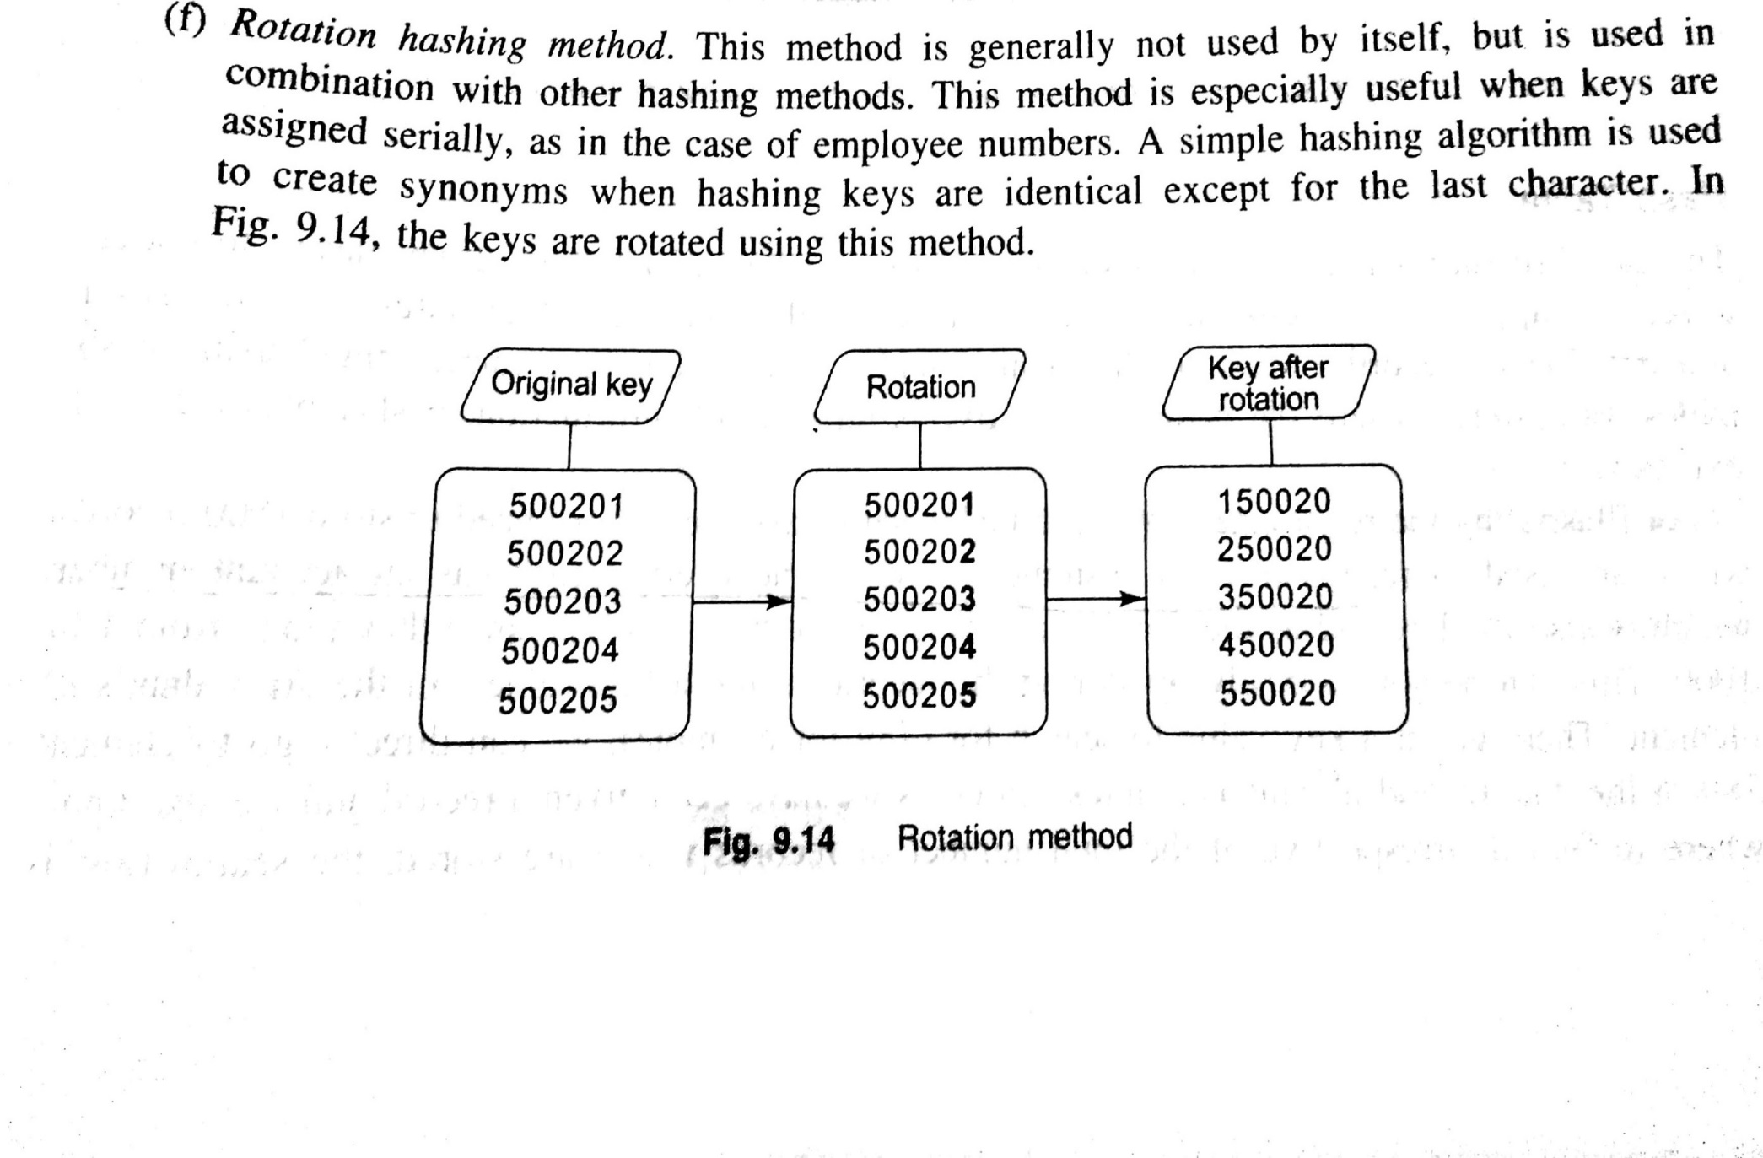

Slide 15
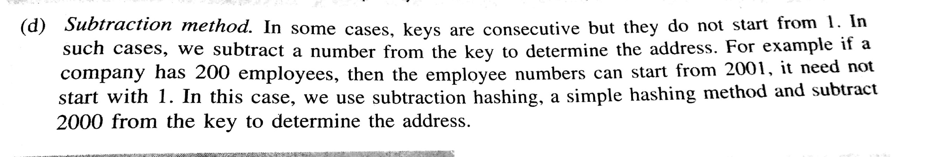

Slide 16
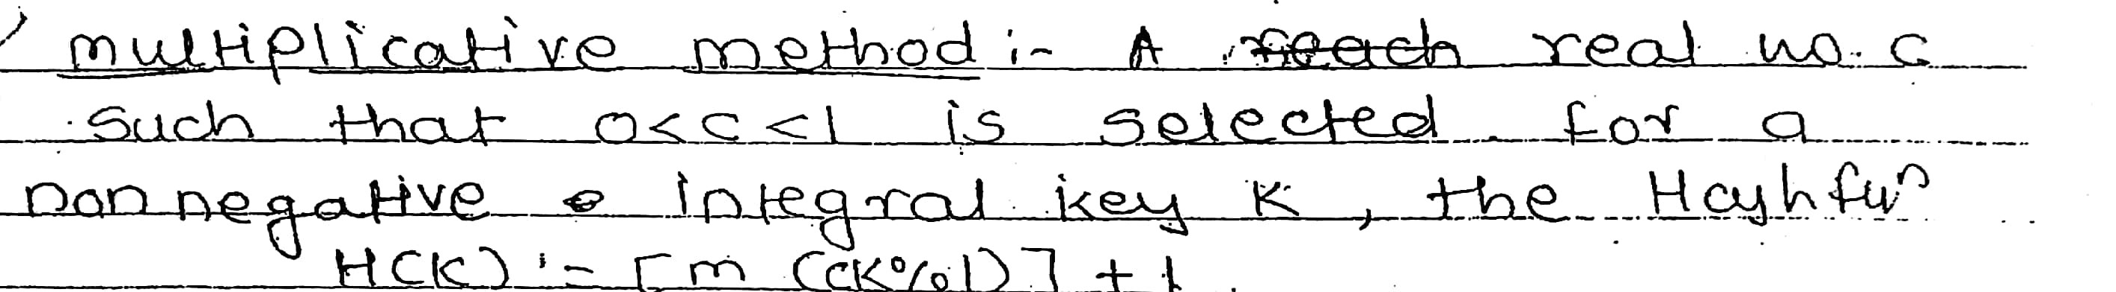

Slide 17
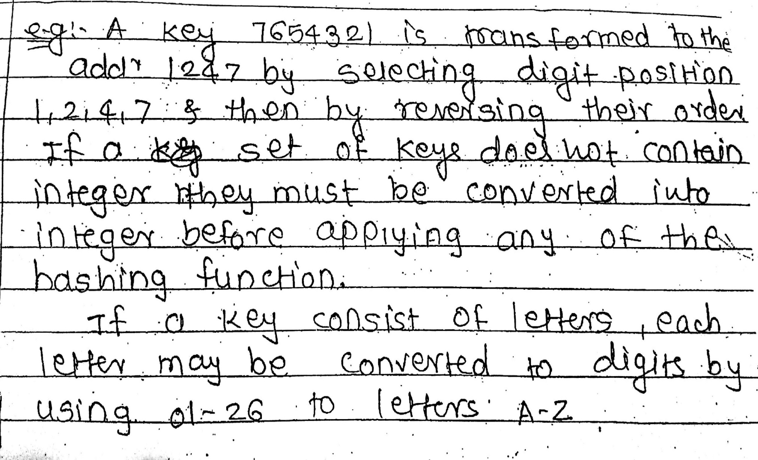
Digit Analysis

Slide 18
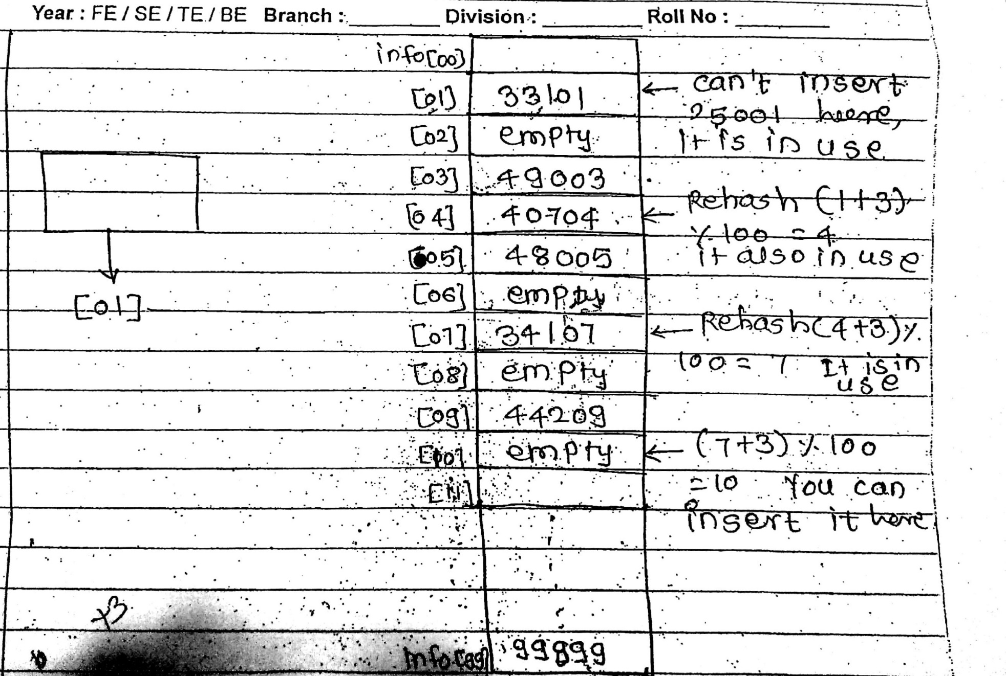
Rehashing

Slide 19
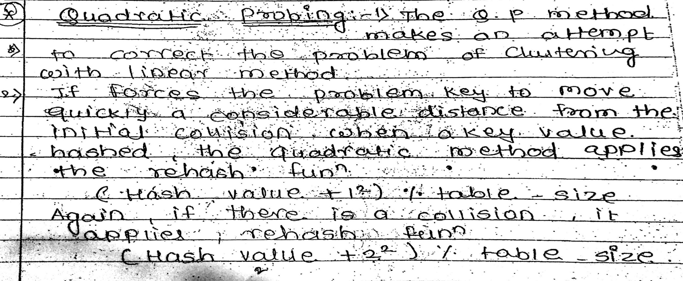
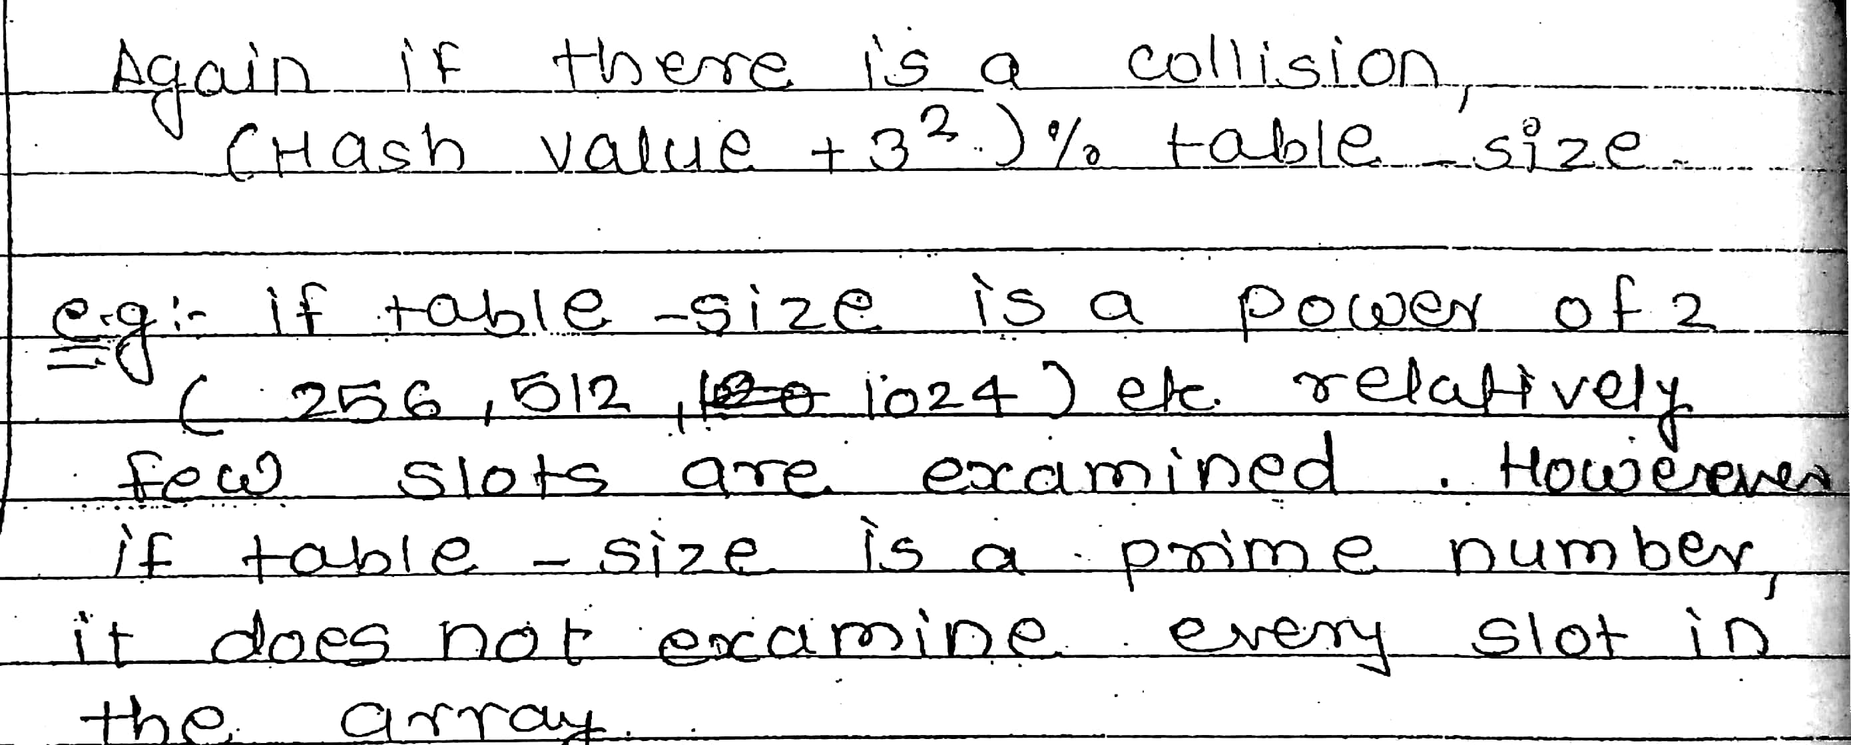

Slide 20
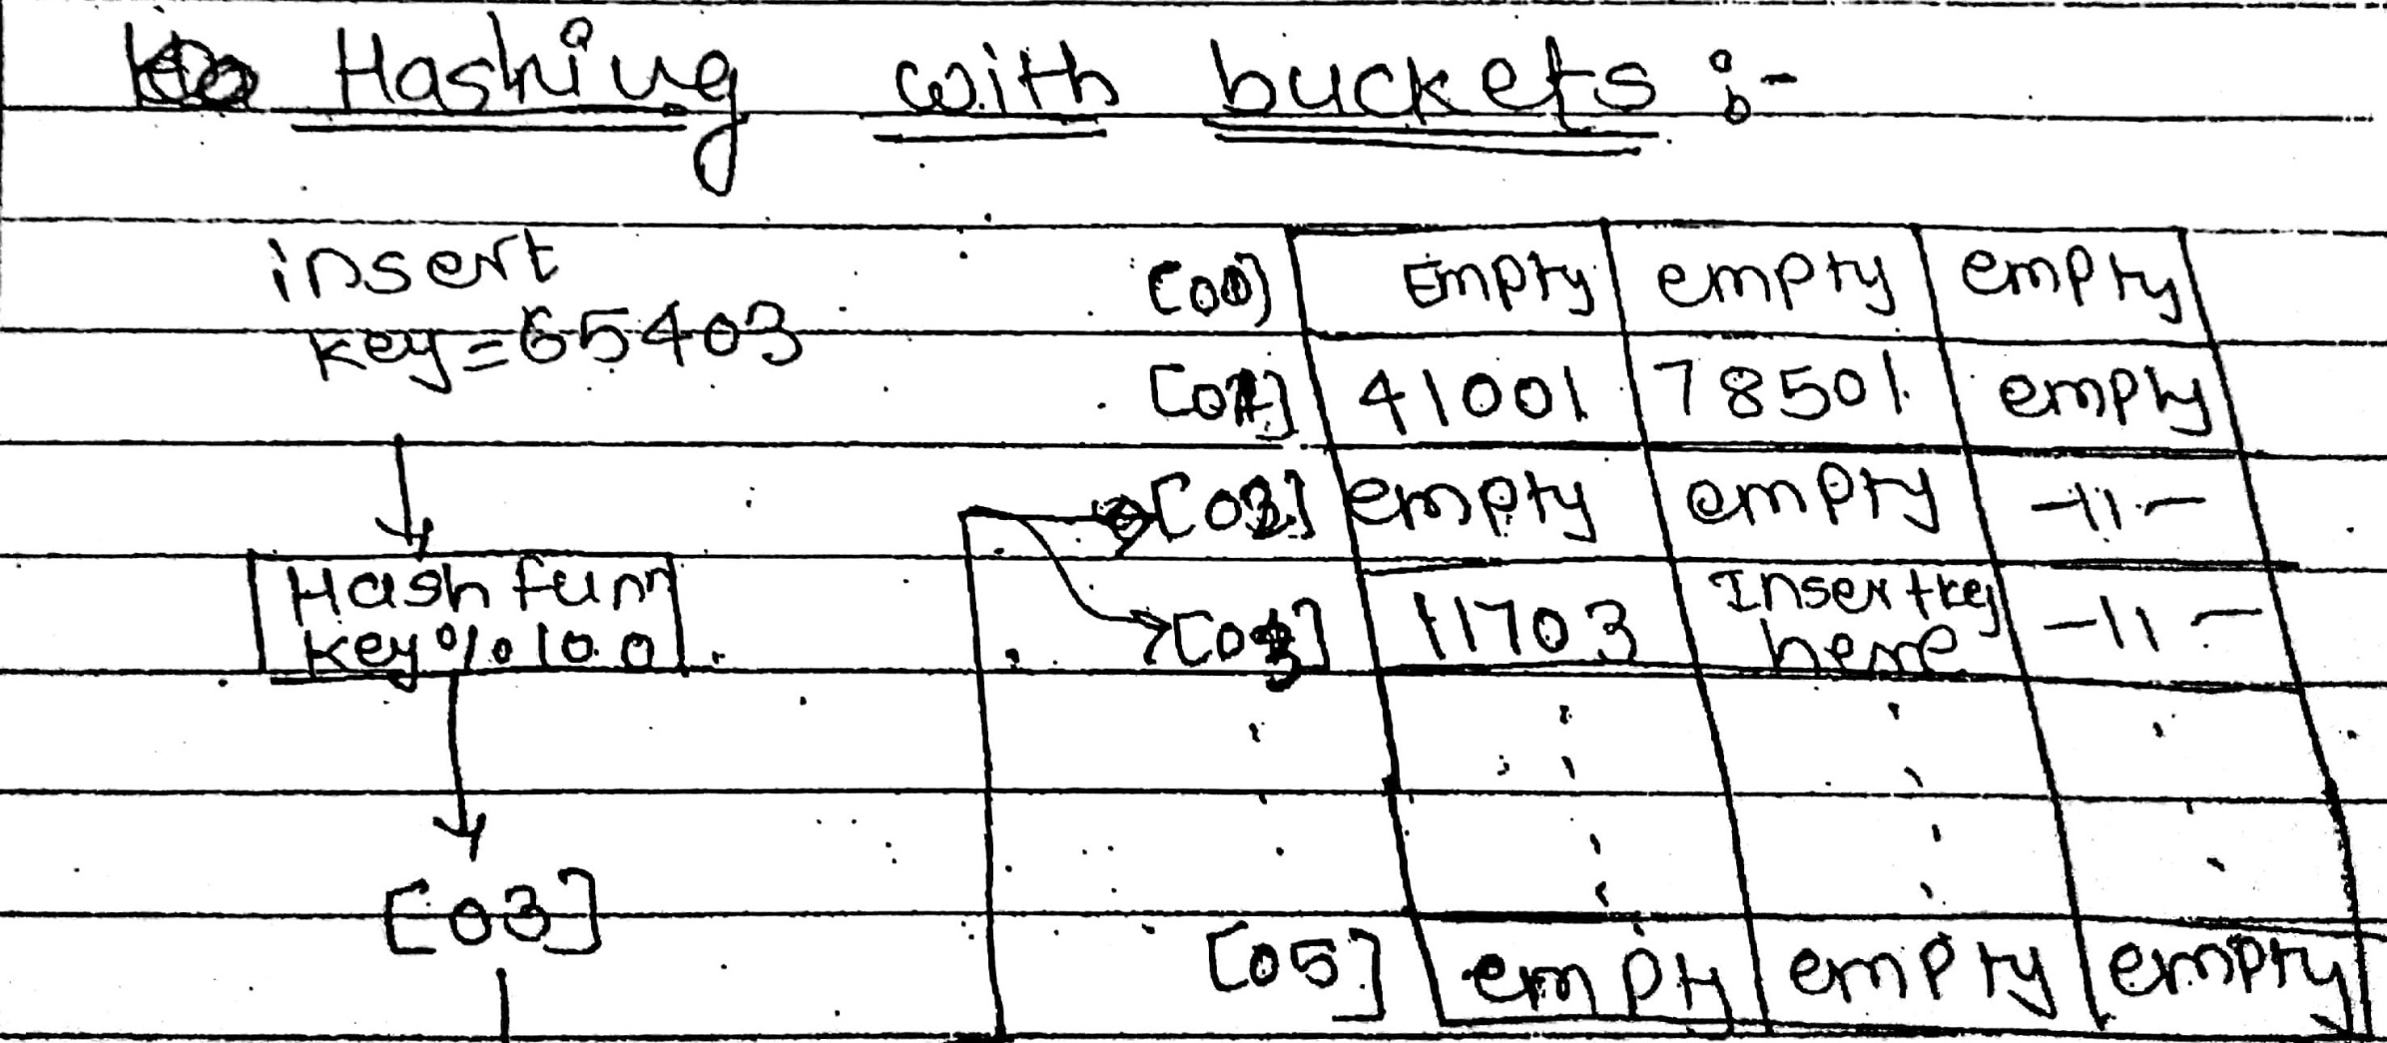

Slide 22
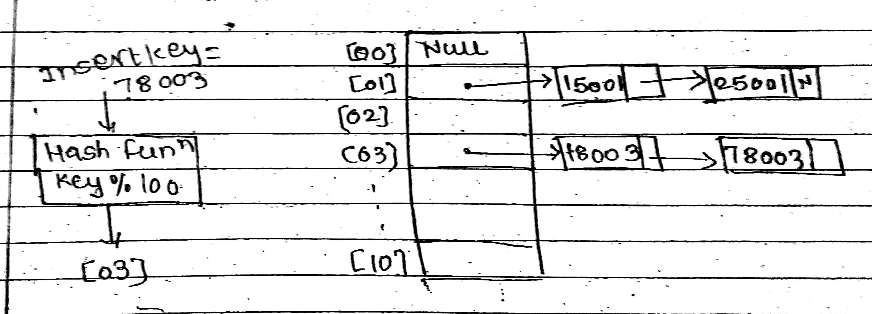
Chaining

Slide 24
Direct hashing
In direct hashing, the key is the data file address without any algorithmic manipulation. The file must therefore contain a record for every possible key. Although situations suitable for direct hashing are limited, it can be very powerful, because it guarantees that there are no synonyms or collisions as with other methods.

Slide 25
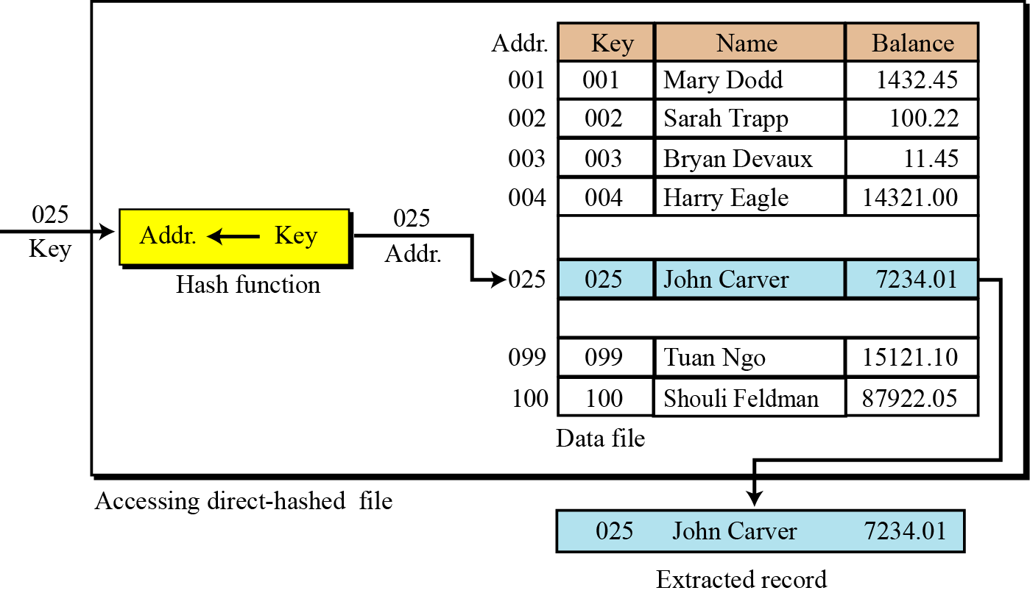
Figure 13.8 Direct hashing

Slide 26
Dynamic Hashing
The dynamic hashing method is used to overcome the problems of static hashing like bucket overflow.
In this method, data buckets grow or shrink as the records increases or decreases. This method is also known as Extendable hashing method.
This method makes hashing dynamic, i.e., it allows insertion or deletion without resulting in poor performance.
How to search a key
First, calculate the hash address of the key.
Check how many bits are used in the directory, and these bits are called as i.
Take the least significant i bits of the hash address. This gives an index of the directory.
Now using the index, go to the directory and find bucket address where the record might be.

Slide 27
How to insert a new record
Firstly, you have to follow the same procedure for retrieval, ending up in some bucket.
If there is still space in that bucket, then place the record in it.
If the bucket is full, then we will split the bucket and redistribute the records.

Slide 28
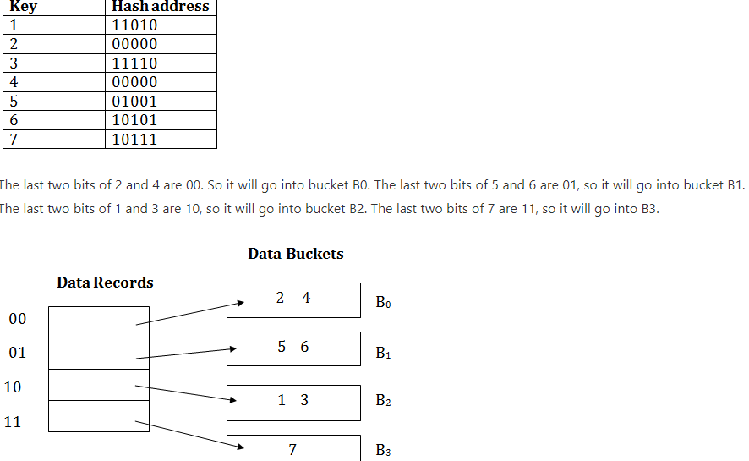
For example:
Consider the following grouping of keys into buckets, depending on the prefix of their hash address:

Slide 29
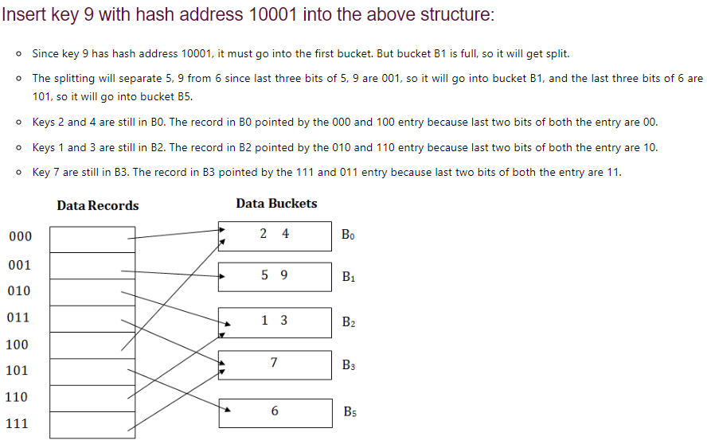

Slide 30
Advantages of dynamic hashing
In this method, the performance does not decrease as the data grows in the system. It simply increases the size of memory to accommodate the data.
In this method, memory is well utilized as it grows and shrinks with the data. There will not be any unused memory lying.
This method is good for the dynamic database where data grows and shrinks frequently.
Disadvantages of dynamic hashing
In this method, if the data size increases then the bucket size is also increased. These addresses of data will be maintained in the bucket address table. This is because the data address will keep changing as buckets grow and shrink. If there is a huge increase in data, maintaining the bucket address table becomes tedious.
In this case, the bucket overflow situation will also occur. But it might take little time to reach this situation than static hashing.

Slide 31
Directory Less Dynamic Hashing
The previous section assumed the existence of a directory that points to pages.
If we have a continuous address space large enough to hold all the records. We can eliminate the directory.
In effect, this leaves it to the operating system to break the address space into pages and to manage moving them into and out of memory.
This scheme is referred to as directory less hashing or linear hashing.

Slide 32
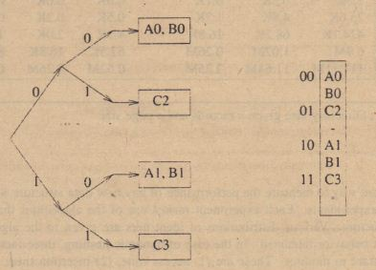
Consider the Figure (a), which has two levels and indexes four pages.
In the new method, the two-bit addresses are the actual addresses of these pages.
Thus, the hash function delivers the actual address of a page containing the key.
Every value produced by the hash function must point to an actual page.
In contrast to the directory scheme, in which a single page might be pointed at by several directory entries, in the directory less scheme there must exist a unique page for every possible address.

Slide 33
What happens when a page overflows? We could double the size of the address space, but this is wasteful.
Instead, whenever an overflow occurs, we add a new page to the end of the file and divide the identifiers in one of the pages between its original page and the new page.
This complicates the handling of the family of hash functions somewhat.
However, If we had simply added one bit to the result of the hash function, the table size would have to be doubled.
By adding only one page, the hash function must distinguish between pages addressed by r bits and those addressed by r + I bits.

Slide 34
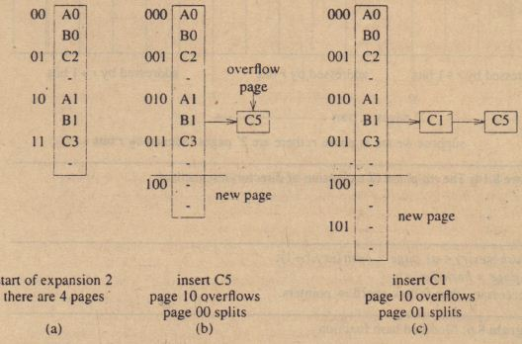
It provides an example of directory less hashing after two insertions. Initially, there are four pages, each addressed by two bits (Figure (a). Two of the pages are full, and two have one identifier each.
When C5 is inserted, it hashes to the page whose address is 10 (Figure (b). Since that page is full, an overflow node is allocated to hold C5.
At the same time, we add a new page at the end of the storage, rehash the identifiers in the first page, and split them between the first and new page.
Unfortunately, none of the new identifiers go into the new page. The first page and the new page are now addressed by three bits, not two as shown in Figure (b).
In the next step, we insert the identifier CI. Since it hashes to the same page as C5, we use another overflow node to store it.
We add another new page to the end of the file and rehash the identifiers in the second page.
Once again none go into the new page.
Now the first two pages and the two new pages are all addressed using three bits. Eventually the number of pages will double, thereby completing one phase.

Slide 35
Bloom Filter
A Bloom filter is a space-efficient probabilistic data structure that is used to test whether an element is a member of a set.
For example, checking availability of username is set membership problem, where the set is the list of all registered username.
The price we pay for efficiency is that it is probabilistic in nature that means, there might be some False Positive results.
False positive means, it might tell that given username is already taken but actually it’s not.

Slide 36
Interesting Properties of Bloom Filters
Unlike a standard hash table, a Bloom filter of a fixed size can represent a set with an arbitrarily large number of elements.
Adding an element never fails. However, the false positive rate increases steadily as elements are added until all bits in the filter are set to 1, at which point all queries yield a positive result.
Bloom filters never generate false negative result, i.e., telling you that a username doesn’t exist when it actually exists.
Deleting elements from filter is not possible because, if we delete a single element by clearing bits at indices generated by k hash functions, it might cause deletion of few other elements.

Slide 37
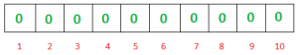
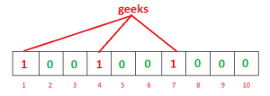
Working of Bloom Filter
A empty bloom filter is a bit array of m bits, all set to zero, like this –
We need k number of hash functions to calculate the hashes for a given input. When we want to add an item in the filter, the bits at k indices h1(x), h2(x), … hk(x) are set, where indices are calculated using hash functions.
Example – Suppose we want to enter “geeks” in the filter, we are using 3 hash functions and a bit array of length 10, all set to 0 initially. First we’ll calculate the hashes as follows:
h1(“geeks”) % 10 = 1
h2(“geeks”) % 10 = 4
h3(“geeks”) % 10 = 7
Note: These outputs are random for explanation only.
Now we will set the bits at indices 1, 4 and 7 to 1 .

Slide 38
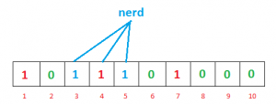
Again we want to enter “nerd”, similarly, we’ll calculate hashes
h1(“nerd”) % 10 = 3
h2(“nerd”) % 10 = 5
h3(“nerd”) % 10 = 4
Set the bits at indices 3, 5 and 4 to 1

Slide 39
Now if we want to check “geeks” is present in filter or not. We’ll do the same process but this time in reverse order.
We calculate respective hashes using h1, h2 and h3 and check if all these indices are set to 1 in the bit array.
If all the bits are set then we can say that “geeks” is probably present.
If any of the bit at these indices are 0 then “geeks” is definitely not present.

Slide 40
False Positive in Bloom Filters
The question is why we said “probably present”, why this uncertainty. Let’s understand this with an example. Suppose we want to check whether “cat” is present or not. We’ll calculate hashes using h1, h2 and h3
h1(“cat”) % 10 = 1
h2(“cat”) % 10 = 3
h3(“cat”) % 10 = 7
If we check the bit array, bits at these indices are set to 1 but we know that “cat” was never added to the filter. Bit at index 1 and 7 was set when we added “geeks” and bit 3 was set we added “nerd”.

Slide 41
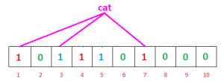
So, because bits at calculated indices are already set by some other item, bloom filter erroneously claims that “cat” is present and generating a false positive result.
Depending on the application, it could be huge downside or relatively okay.
We can control the probability of getting a false positive by controlling the size of the Bloom filter.
More space means fewer false positives.
If we want to decrease probability of false positive result, we have to use more number of hash functions and larger bit array.

Slide 42
Operations that a Bloom Filter supports
insert(x) : To insert an element in the Bloom Filter.
lookup(x) : to check whether an element is already present in Bloom Filter with a positive false probability.

Slide 43
Choice of Hash Function
The hash function used in bloom filters should be independent and uniformly distributed.
They should be fast as possible.
Generating hash is major operation in bloom filters.

Slide 44
Count Min Sketch
The Count-min sketch is a probabilistic data structure.
The Count-Min sketch is a simple technique to summarize large amounts of frequency data.
Count-min sketch algorithm talks about keeping track of the count of things. i.e, How many times an element is present in the set.
What is Count-min sketch and how does it work?
Count-min sketch approach was proposed by Graham Cormode and S. Muthukrishnan.
Count-min sketch is used to count the frequency of the events on the streaming data.
Count-min sketch algorithm also works with hash codes.
It uses multiple hash functions to map these frequencies on to the matrix.

Slide 45
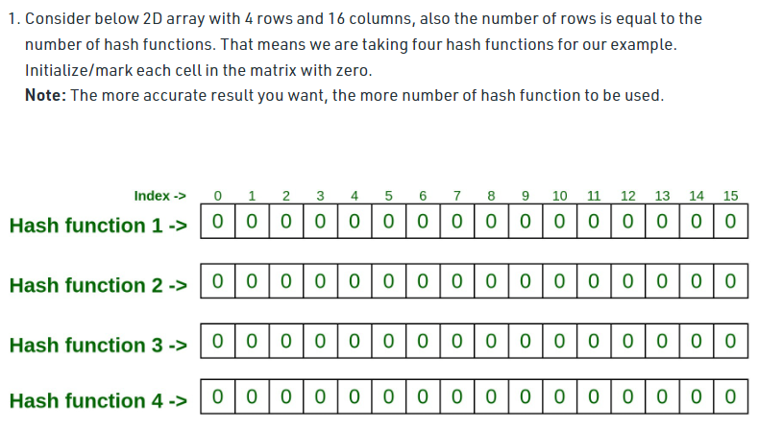

Slide 46
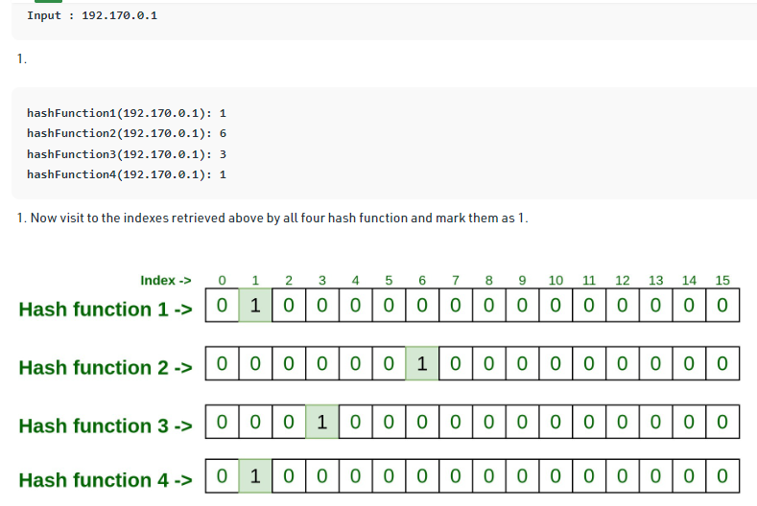

Slide 47
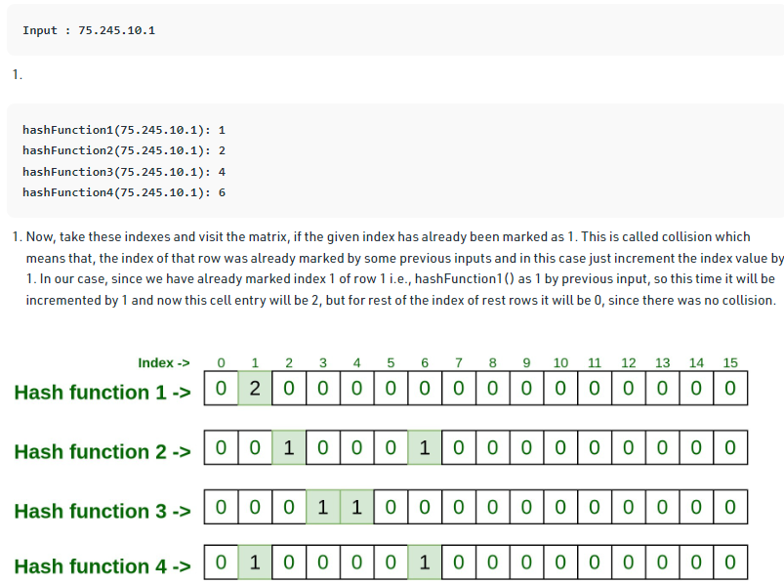

Slide 48
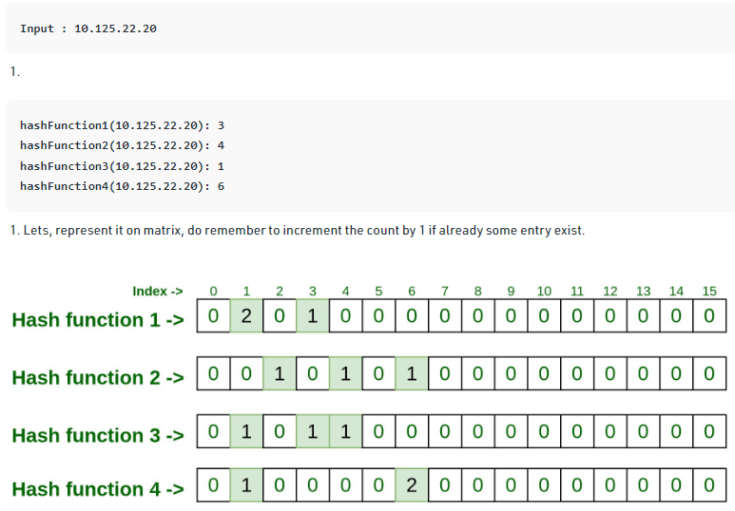

Slide 49
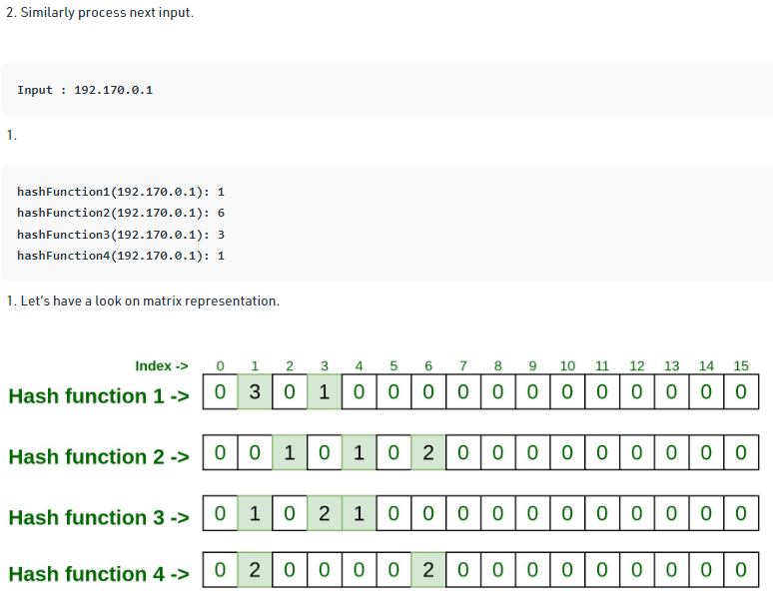

Slide 50
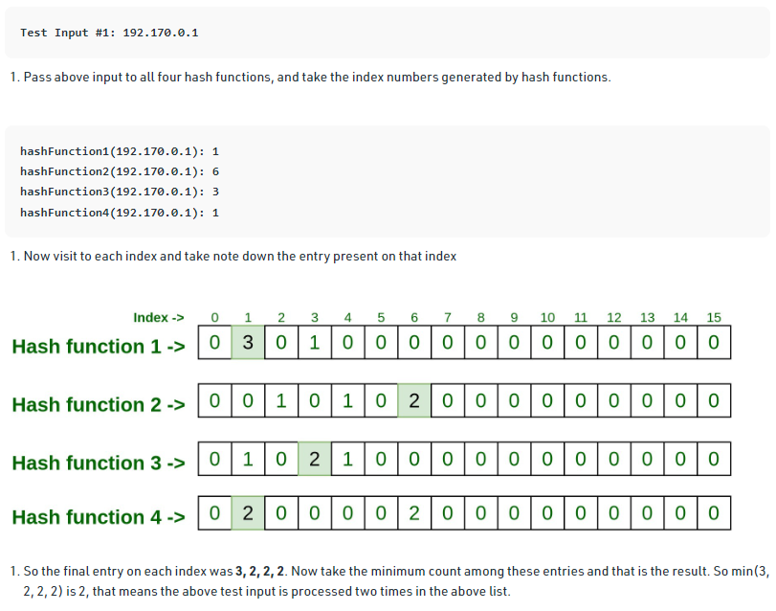

Slide 51
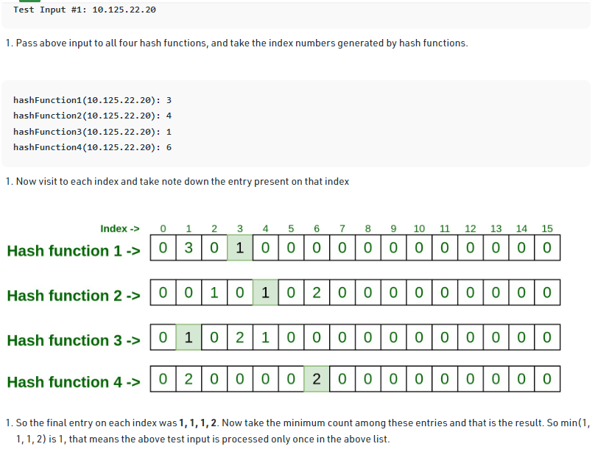

Slide 52
